Slide 1

NAME: E.G.PRADEEP ROLL NO : RA2211004050026 DEP: B.TECH.ECE SUB: DESIGN THINKING METHODOLOGY SUB CODE : 21DCS201P

Slide 2
BUISSNESS MODEL CANVAS : The Business Model Canvas (BMC) is a strategic management tool that allows entrepreneurs and businesses to describe, design, challenge, invent, and pivot their business model. It's a visual chart with elements describing a firm's or product's value proposition, infrastructure, customers, and finances. Developed by Alexander Osterwalder and Yves Pigneur, the BMC consists of nine building blocks: 1.Customer Segments: Identifying the different groups of people or organizations you aim to reach and serve. 2.Value Propositions: Describing the products or services you offer that solve problems or satisfy needs for your customer segments. 3.Channels: Outlining how you reach and deliver your value proposition to your customer segments. 4.Customer Relationships: Detailing the types of relationships you establish and maintain with your customer segments.

Slide 3
5.Revenue Streams: Identifying the sources of revenue generated by your business model. 6.Key Resources: Enumerating the assets necessary to deliver your value proposition, reach your customer segments, maintain relationships, and earn revenue. 7.Key Activities: Describing the most important tasks your business needs to perform to operate successfully. 8.Key Partnerships: Identifying the external entities you need to leverage to make your business model work. 9.Cost Structure: Listing all the costs incurred to operate your business model. The BMC is particularly useful in startups and new ventures for quickly assessing and iterating on business ideas. Its visual nature facilitates brainstorming, collaboration, and communication among team members and stakeholders. By filling out the canvas, businesses can gain insights into their operations, potential areas for improvement, and strategies for growth.

Slide 4
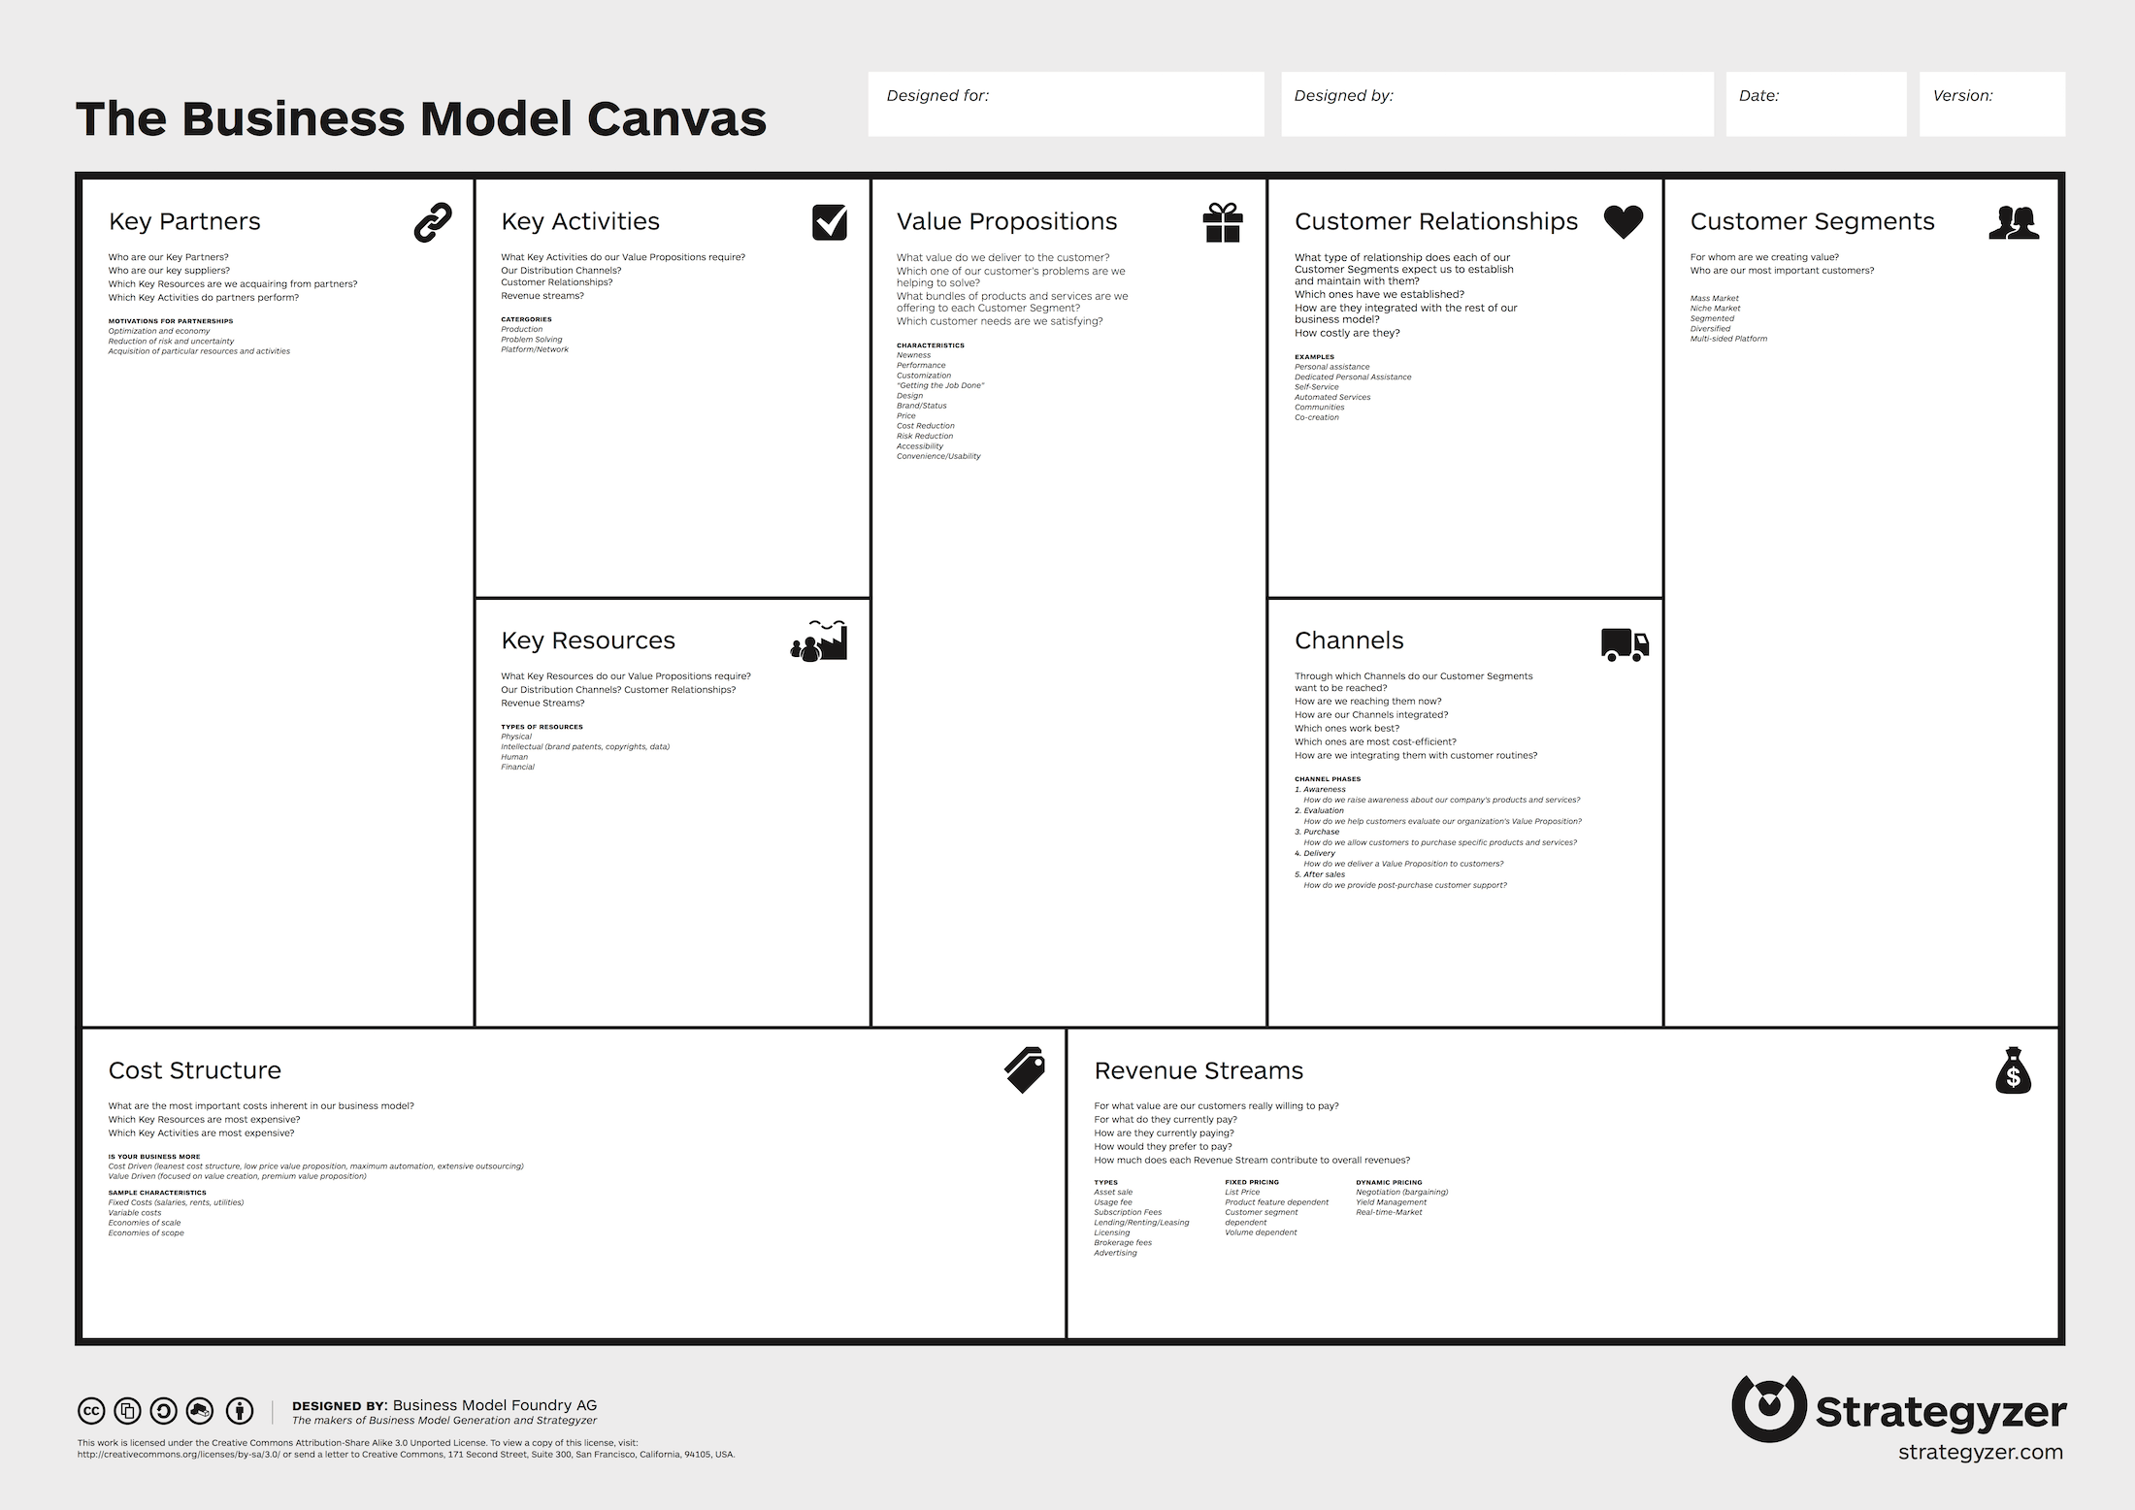
BUISSNESS MODEL CANVAS TEMPLATE:

Slide 5
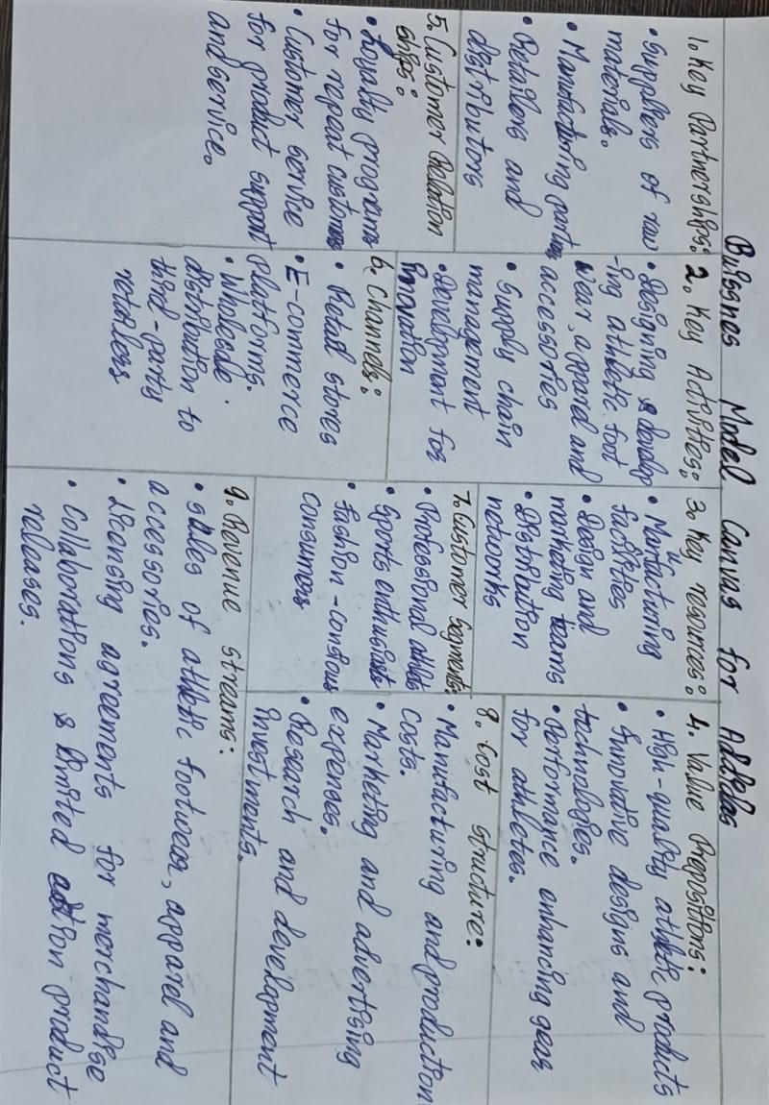
MY ASSIGNMENT :

Slide 6
THANK YOU

